Slide 1


IMDb Reviews Analysis
Make the most from user reviews
Nir Shelly & Shani Noy
October 2020

Slide 2
Main things we did and challenges
Analyzing the text:
Test if there are NA
Test if data is balanced
Explore our text: are there special characters (as <br \>), length of text
Which tokenizer to use (word_tokenize / RegexpTokenizer from nltk)

Slide 3
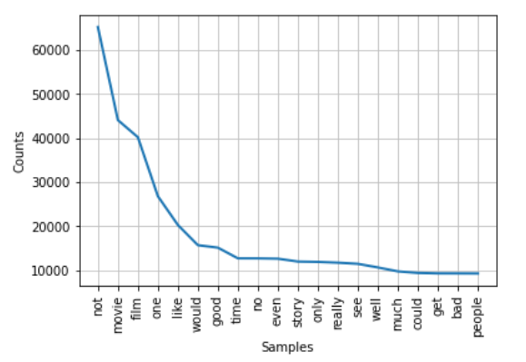
Main things we did and challenges
Analyzing the text:
Which words are most used (after we preprcossed the text)

Slide 4
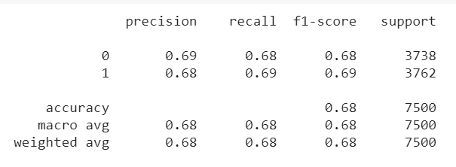
Main things we did and challenges
Preprocessing the text
Creating a function to preprocess (see clean_reviews function)
Classification of reviews (supervised model)
Running Doc2Vec and using DecisionTreeClassifier

Slide 5
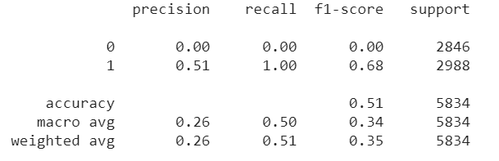
Main things we did and challenges
Classification of reviews (supervised model)
Running Word2Vec and using DecisionTreeClassifier

Slide 6
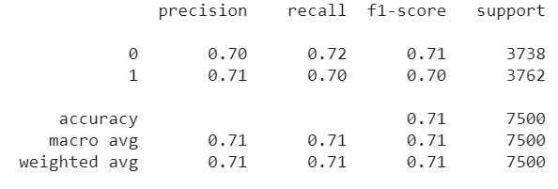
Main things we did and challenges
Classification of reviews (supervised model)
Running Dord2Vec and using DecisionTreeClassifier , and building model from training dataset only (model.build_vocab(train_corpus))
Vector size = 50
DecisionTree Model

Slide 7
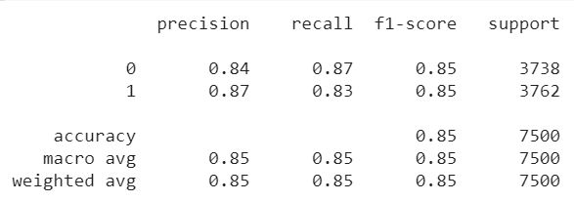
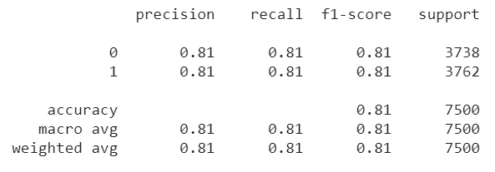
Main things we did and challenges
Classification of reviews (supervised model)
..continue
SVM Model
RandomForest Model

Slide 8
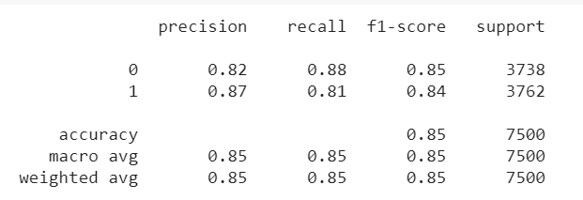
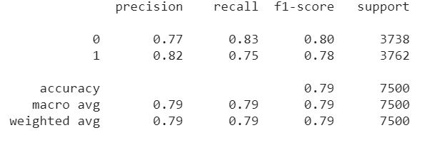
Main things we did and challenges
Classification of reviews (supervised model)
..continue
Logistic Regression Model
Naive Base Model

Slide 9
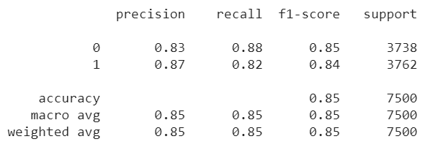
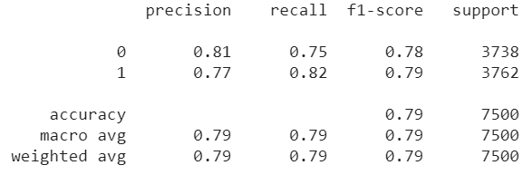
Main things we did and challenges
Classification of reviews (supervised model)
..continue
LinearSVC Model
KNN Model (k=7)

Slide 10



Main things we did and challenges
Classification of reviews (supervised model)
..continue
FastText
FastText with cleaned text
FastText with cleaned text and learning rate=0.05, epochs=30

